Slide 1
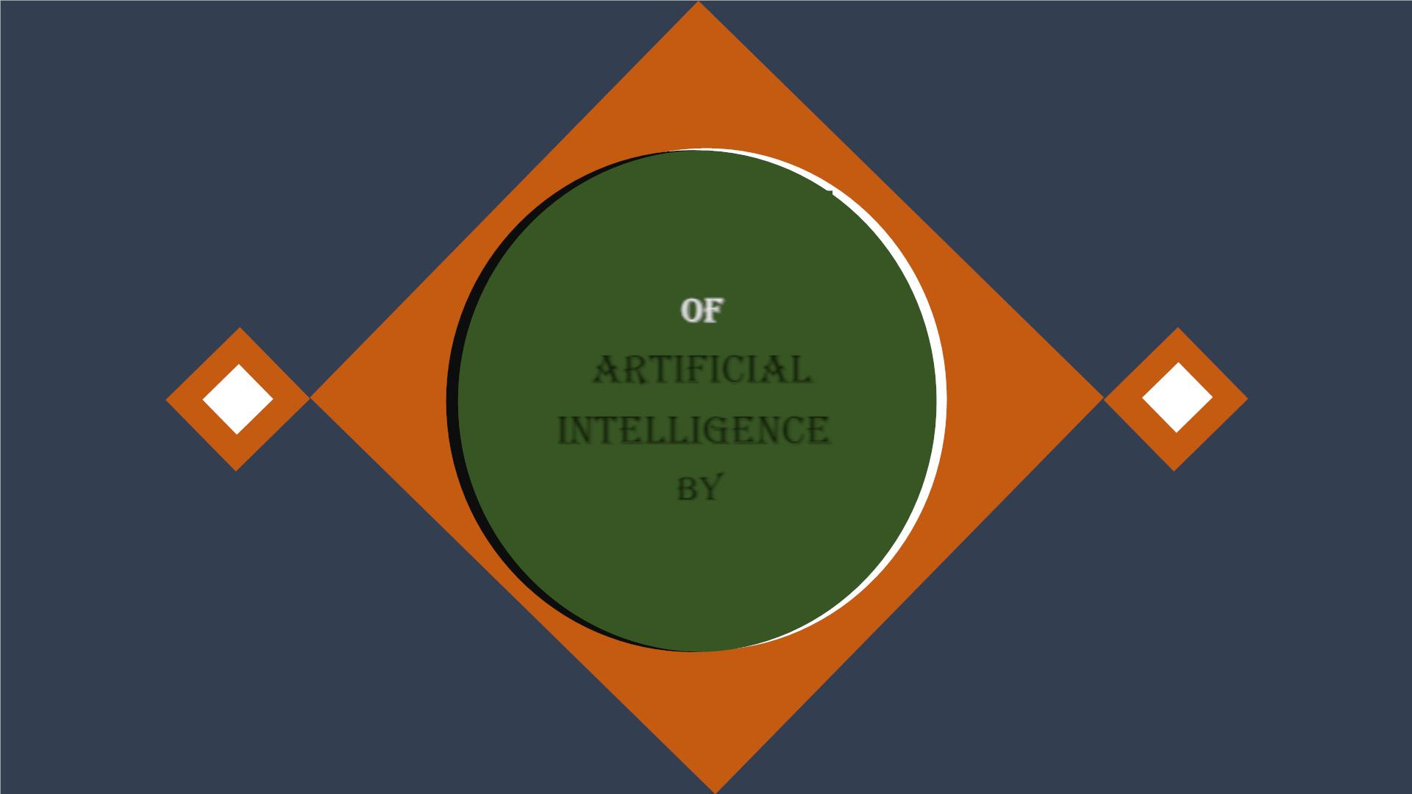
of
artificial
intelligence
by

Slide 2
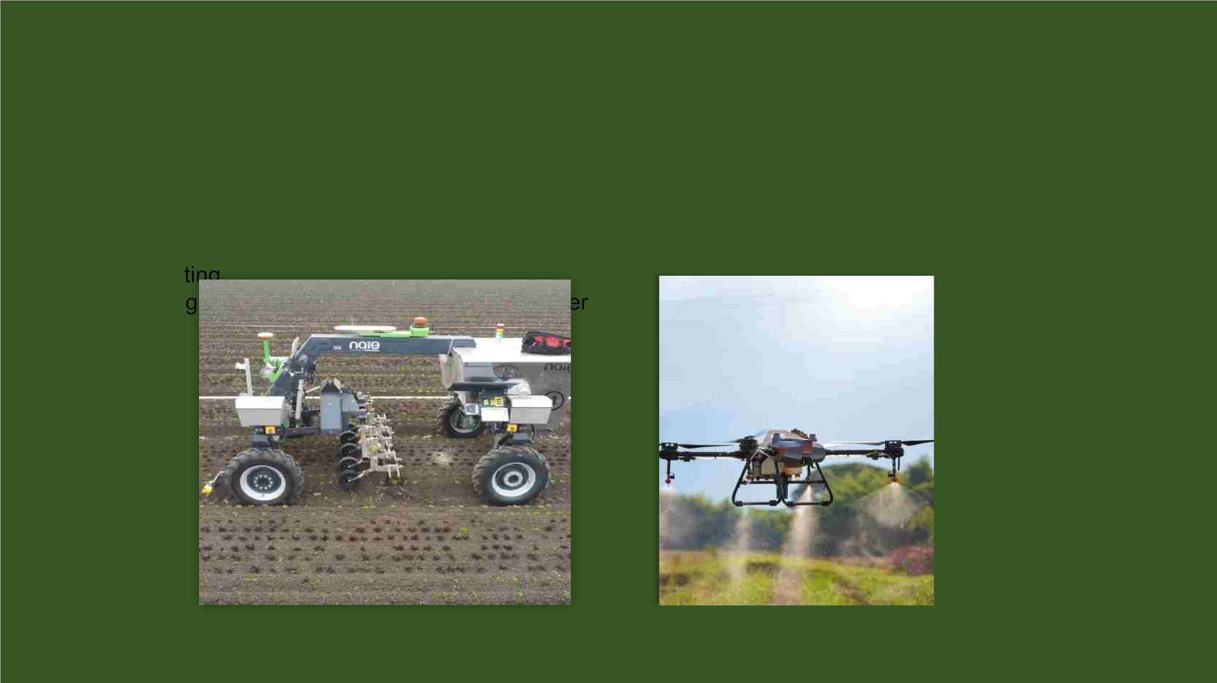
Agriculture
:
q Agriculture is an area which requires various resources, labor, money, and time for best result. Now a
day’s agriculture is becoming digital, and AI is emerging in this field.
q In addition, drones are also used for spraying insecticides and detecting weed formation in large farms.
This is getting to help firms like Blue River Technologies, Naio Technologies & etc… better manage the
farms.
q Agriculture is applying AI as agriculture robotics, solid and crop monitoring, predictive analysis
q AI has also enhanced crop production and improved real-time monitoring, harvesting, processing and
marke
q AI in a
s
Naio Technologies
Drone

Slide 3
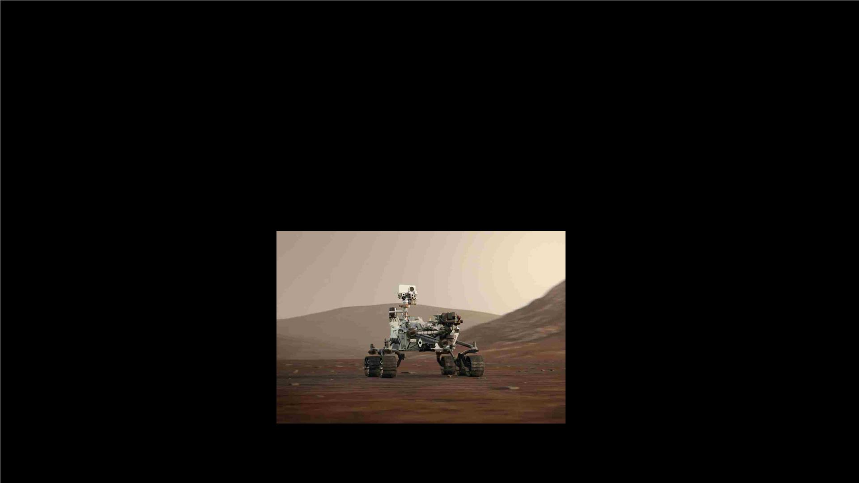
Space
Exploration:
q AI systems are being developed to scale back the danger of human life that venture into the vast
realms of the undiscovered and unraveled universe which is a very risky task that the astronauts need
to take up.
q As a result, unmanned space exploration missions just like the Mars Rover are possible due to
utilization of AI.
q It has helped us discover numerous exoplanets, stars, galaxies, and more recently, two new planets in
our very own system.
q NASA is also working with AI applications for space exploration to automate image analysis and to
develop autonomous spacecraft that would avoid space debris without human intervention, create
communication networks more efficient and distortion-free by using an AI-base device.
Mars Perseverance Rover

Slide 4
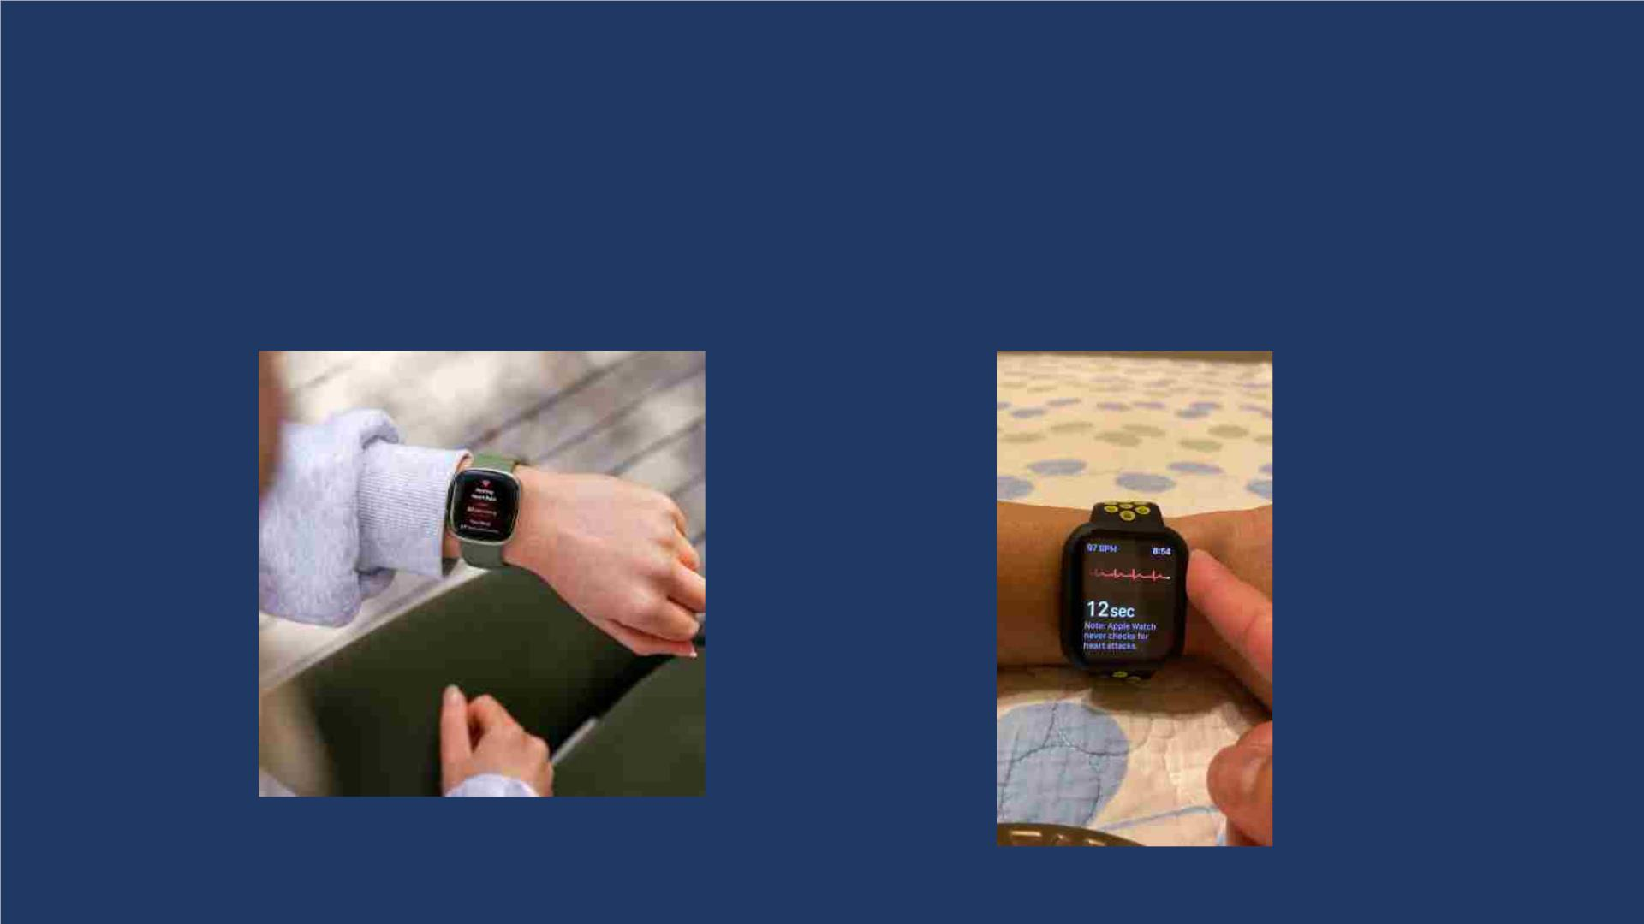
Health Care
:
q In the last, five to ten years, AI becoming more advantageous for the healthcare industry and going to have a
significant impact on this industry.
q Healthcare Industries are applying AI to make a better and faster diagnosis than humans. AI can help
doctors with diagnoses and can inform when patients are worsening so that medical help can reach to the
patient before hospitalization.
q A device, as common as a Fitbit or an iwatch collect a lot of data like the sleep patterns of the individual, the
calories burnt by him, heart rate and a lot more which can help with early detection, personalization, even
disease d
Fitbit
Apple (iwatch)

Slide 5
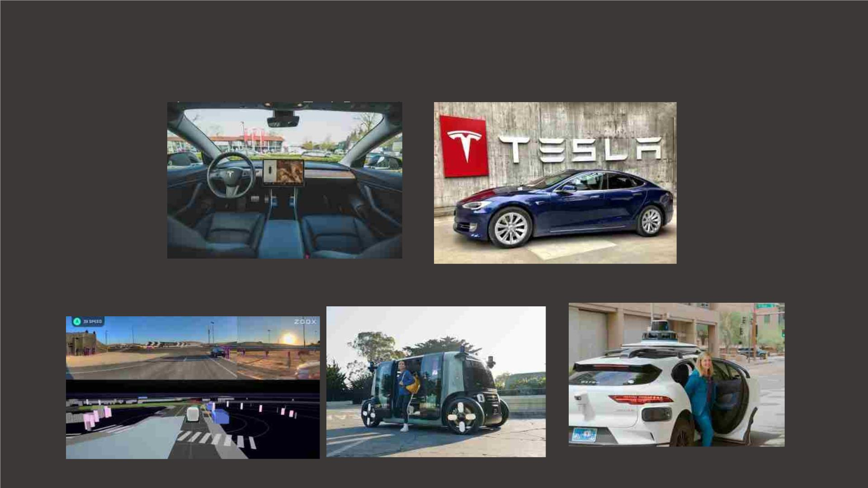
Automobile Industry :
q Some Automotive industries are using AI to provide virtual assistant to their user for better
performance.
q Such as Te a ha n odu ed e a o an ntelligen
ua a
n
q Various Industries are currently working for developing self-driven cars which can make your
journey more safe and secure.
WAYMO
ZOOX

Slide 6

Meteorology:
q AI can reduce the workload of meteorologists, thereby improving the accuracy of weather forecasts.
q The speed and accuracy of AI technologies when it comes to processing data in extreme weather
conditions means that scientists will have a better chance of alerting people in danger.
q Researchers are collecting information about AI’s potential to detect some hard-to-notice clouds that are
concurrent with cyclone formation. The proposed model was 99% accurate, and worked in just
40seconds.
q Scientists are doing that with AI system, machine learning, neural networks, and deep learning, because
their pattern recognition capabilities are tailor-made for the job.
q The system can be fed massive amount of data and learn how to spot a storm that might produce
lightening or tornadoes.

Slide 7

Manufacturing:
q Defect detection, predictive maintenance, liquid level analysis, asset inspection are all being
shaped by AI solutions based on computer vision and machine learning.
q AI-enabled software can help create several optimized designs for a single product.
Engineers to provide certain input parameters such as:
v Raw materials
v Size and Weight
v Manufacturing methods
v Costs and other resource constraints
q Cars, Bikes, Trucks, Airplanes, Tiers, All Home Appliances, etc.. Were is using AI to develop
never-seen before in the blink of eye. Humans it takes several months, or even years to do this
q This Technology used to pick the right recipes that leads to the least amount of raw material and
energy waste

Slide 8

E-Commerce :
q AI is giving the e-commerce industry a competitive advantage, and it is becoming increasingly
demanded in the market. Shoppers can use AI to find related products in their preferred size, color, or
brand.
Ø Personalized Shopping : AI used to construct recommendation engines that help you engage with end
customers more effectively. These suggestions browsing behavior, preferences, and interests.
Ø AI-Powered assistants : Virtual shopping assistants and chatbots aid in the enhancement of the online
buying experience. NLP is used to make the dialogue sound more human and personal. It can interact
with your consumers in real-time.

Slide 9

Finance:
q AI and finance industries are the best matches for each other. The finance industry is implementing
automation, chatbot, adaptive intelligence, algorithm trading, and machine learning into financial
processes.
q Artificial Intelligence provides features like risk assessment, fraud detection, and management, financial
advisory services, Automated trading in Finance.
q Leading Indian banks such as STATE BANK OF INDIA,ICIC BANK, HDFC BANK, AXIS BANK, KOTAK
MAHINDRA BANL.
q In Abroad Banks like the City National of Florida and JPMorgan Chase & Co have tested facial
recognition and AI technologies

Slide 10

Entertainment:
q We are currently using some AI based applications in our daily life with some entertainment
services such as Netflix or Amazon.
q Using machine learning, users behavior and demographic details, music or videos are
recommended like what kind of movies they like most.
q AI helps develop AR/VR interactive content based on the storyline and themes for content, gaming
and events.

Slide 11

The End

